Slide 1


Dining Philosopher Problem
Presented by: Raghav Sharma (2021A1R045)
Vaibhav Sabherwal (2021A1R048)
Sayeum Mahajan (2021A1R034)
Rassia Bharti (2022A1L010)

Slide 2
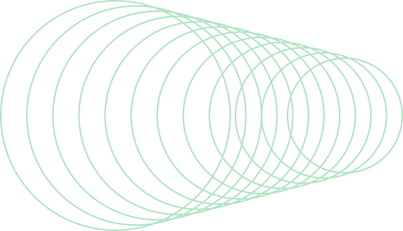
Conent
Problem Statement
Diagram
Objective
Semaphore
Deadlock
Flowchart
Algorithm
Proposed Solutions
Implementation
References

Slide 3

Dining Philosophers Problem
The problem is how to design a regime such that no philosopher will starve.
Five philosopher are in a thinking – eating cycle.
When a philosopher gets hungry, he sits down, picks up two nearest chopsticks and eats.
A philosopher can eat only if he has both chopsticks.
After eating, he puts down both chopsticks and thinks.
This cycle continues.

Slide 4
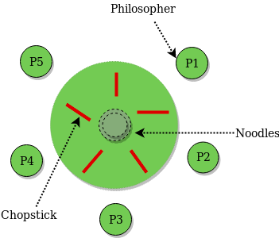

Diagramatic Representation

Slide 5
OBJECTIVE
In computer science, the dining philosophers problem is an example problem often used in concurrent algorithm design to illustrate synchronization issues and techniques for resolving them.
Philosophy as a process functions as an activity which responds to society's demand for wisdom, which is bringing together all that we know in order to obtain what we value.

Slide 6
WHAT IS SEMAPHORE?
SEMAPHORE IS A SIMPLY A VARIABLE. THIS VARIABLE IS USED TO SOLVE CRITICAL SECTION PROBLEM AND TO ACHIEVE PROCESS SYNCHRONZATION IN THE MULTI PROCESSING ENVIRONMENT.
IT CONSISTS OF A COUNTER, A WAITING LIST OF PROCESSES AND TWO METHODS (E.G, FUNCTIONS): SIGNAL AND WAIT.

Slide 7
WHAT IS DEAD-LOCK ?
A DEADLOCK IS A SITUATION IN WHICH MORE THAN ONE PROCESS IS BLOCKED BECAUSE IT IS HOLDING A RESOURCE AND ALSO REQUIRES SOME RESOURCE THAT IS ACQUIRED BY SOME OTHER PROCESS. THEREFORE, NONE OF THE PROCESSES GETS EXECUTED..
➢NECESSARY CONDITIONS FOR DEADLOCK :
MUTUAL EXCLUSION
HOLD AND WAIT
NO PREEMPTION
CIRCULAR WAIT

Slide 8
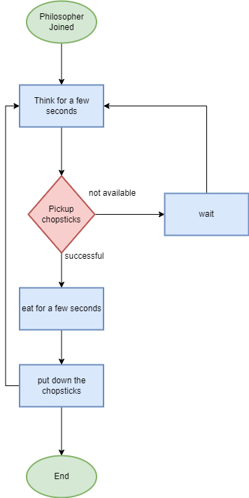
Flowchart

Slide 9
Algorithm
philosopher int P[5] ;
While ( TRUE)
/*Thinking*/
P ( fork [j]) ; /*Pick up left fork*/
P ( fork [i+l] mod 5 ) ; /*Pick up right fork */
eat ( ) ;
V ( fork [i]);
Philosopher 4 ( ) {
While ( TRUE) {
../*Thinking*/
P ( fork [O] ) ; /*Pick up right fork*/
P ( fork [4] ) ; /*Pick up left fork*/
eat( ) ;
V ( fork [4] ) ;
v (fork
Semaphore fork [5] = {1, 1, 1, 1, 1};
fork (philosopher),
fork (philosopher), 1, 1)
fork (philosopher),
fork (philosopher), I, 3)
fork (philosopher),

Slide 10
What is mutex?
In computer programming, a mutex (mutual exclusion object) is a program object that is created so that multiple program thread can take turns sharing the same resource, such as access to a file.
Only one process at a time is allowed in the critical section for a resource.
No deadlock or starvation.
.

Slide 11
Solution of Dining Philosophers Problem
A solution of the Dining Philosophers Problem is to use a semaphore to represent a chopstick, A Chopstick can be picked up by executing a wait
operation on the semaphore and released by executing a Signal
semaphore.

Slide 12
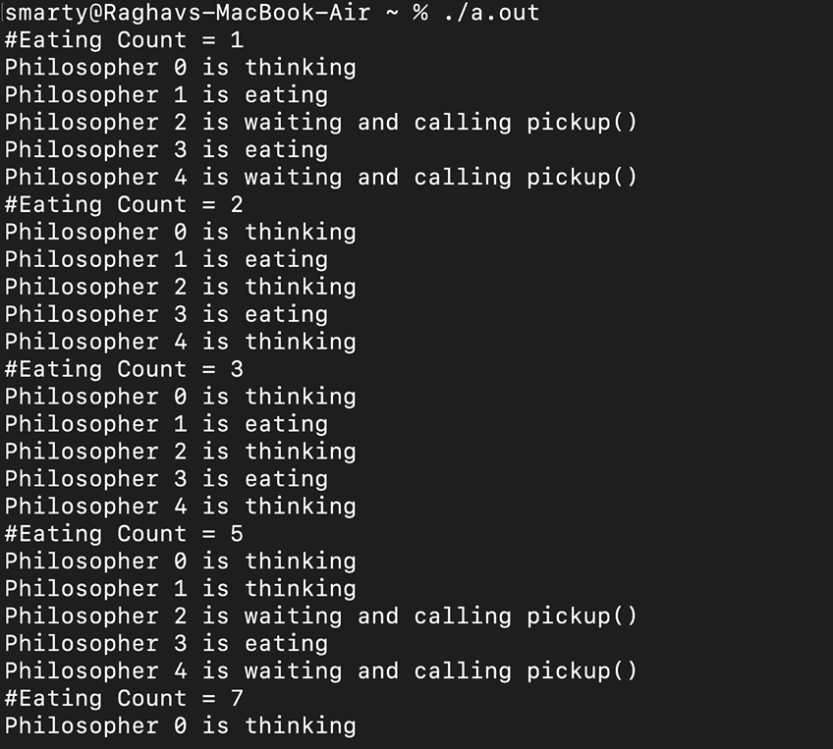
Implementation

Slide 13

References
Code – https://github.com/topics/dining-philosophers-problem
https://www.geeksforgeeks.org/dining-philosopher-problem-using-semaphores/
https://www.tutorialspoint.com/dining-philosophers-problem-dpp
Algorithm – geekforgeeks , Java point, Edukera and Wikipedia.
Diagram -https://media.geeksforgeeks.org/wp-content/uploads/dining_philosopher_problem.png

Slide 14
Thank you

